Slide 1



19CSE311
COMPUTER SECURITY
Elgamal Cryptosystem based Chat Application

Slide 2




OVERVIEW
In today's interconnected local network environments, the confidentiality and integrity of communication are paramount concerns for computer security. This project addresses the critical need for secure messaging by developing a chat application fortified with the ElGamal cryptosystem. ElGamal, a robust public-key encryption algorithm, provides a strong cryptographic foundation for secure message exchange. We've implemented this system to ensure that sensitive information remains protected from unauthorized disclosure and tampering. This application, built using Typescript and React, makes use of websockets and Elgamal cryptosystem to ensure secure one-on-one communication in a local network .

Slide 3

ELGAMAL CRYPTOSYSTEM: INTRODUCTION
The ElGamal cryptosystem, conceived by Taher Elgamal, is a robust asymmetric encryption algorithm designed for secure data transmission. Unlike symmetric encryption, ElGamal eliminates the necessity for a pre-shared secret key, simplifying secure communication over untrusted networks. This characteristic is particularly advantageous in distributed systems and scenarios where secure key distribution is inherently difficult, such as in ad-hoc networks or large-scale online exchanges. Its mathematical foundation in the discrete logarithm problem allows for secure key generation and message encryption within a finite field, providing a practical basis for its real-world applications.

Slide 4

ELGAMAL CRYPTOSYSTEM: SECURITY
ElGamal security relies on the Discrete Logarithm Problem (DLP):
DLP Foundation: The difficulty of calculating 'x' in y = g^x mod p is the cornerstone of ElGamal's security.
Parameter Strength: Large prime 'p' and a strong generator 'g' are essential. Weak parameters compromise security.
Malleability Mitigation: ElGamal's inherent malleability is addressed by hashing messages before encryption. This ensures message integrity.
Ephemeral Key Security: 'k' must be truly random and never reused. Predictable 'k' exposes vulnerabilities.
Private Key Protection: The private key 'x' must be kept secret. Its compromise allows decryption of all messages.

Slide 5

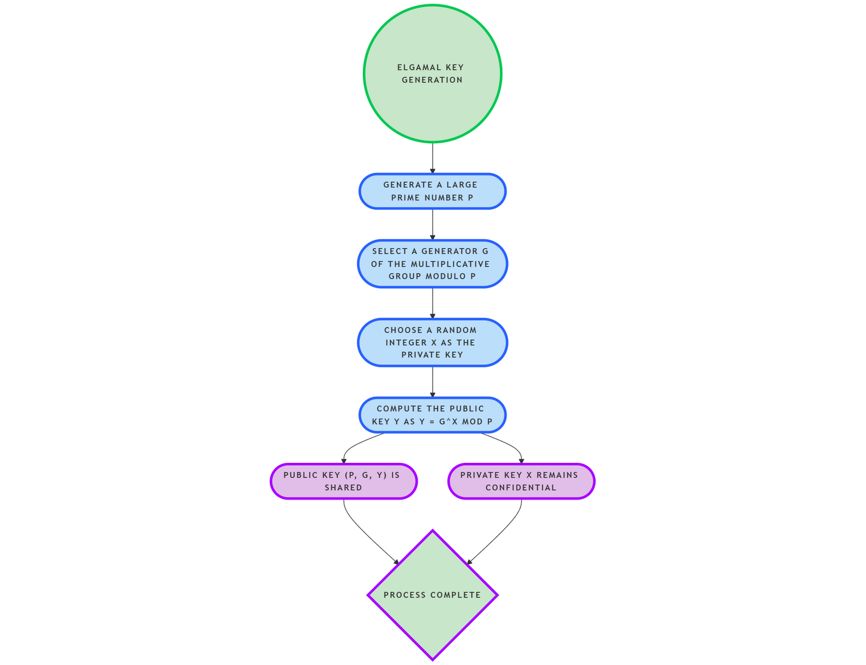
ELGAMAL CRYPTOSYSTEM:
KEY GENERATION
ElGamal key generation involves these precise steps:
1. Generate a large prime number 'p', providing a large finite field.
2. Select a generator 'g' of the multiplicative group modulo 'p', ensuring that the powers of 'g' generate all elements of the group.
3. Choose a random integer 'x' as the private key, where 1 < x < p-1.
4. Compute the public key 'y' as y = g^x mod p.
The public key (p, g, y) is then shared, while the private key 'x' remains confidential.

Slide 6
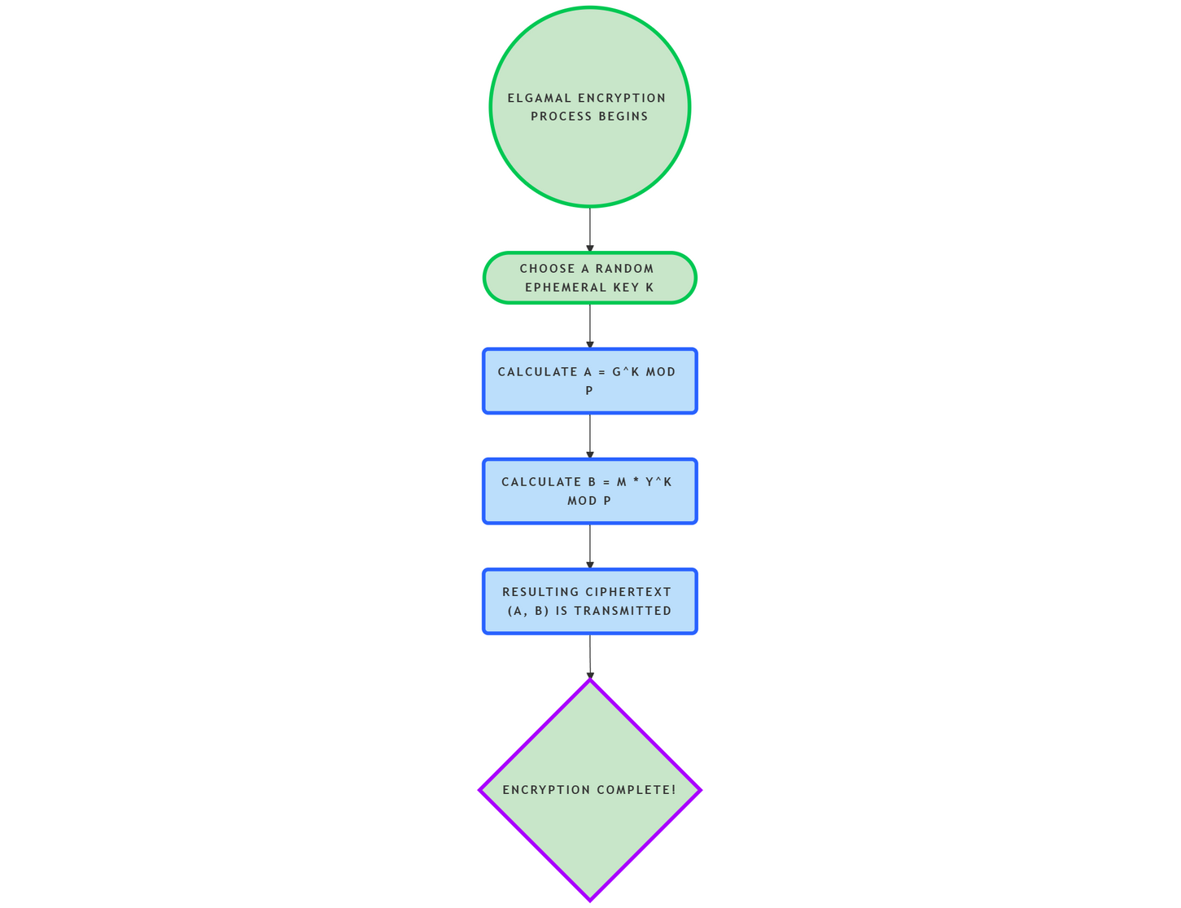
ELGAMAL CRYPTOSYSTEM:
ENCRYPTION
ElGamal encryption transforms plaintext 'm' into ciphertext (a, b) through these operations.
Choose a random ephemeral key 'k', where 1 < k < p-1.
Calculate 'a' as a = g^k mod p.
Calculate 'b' as b = m * y^k mod p.
The resulting ciphertext (a, b) is then transmitted. This process introduces randomness, ensuring that each encryption of the same message yields a different ciphertext.

Slide 7
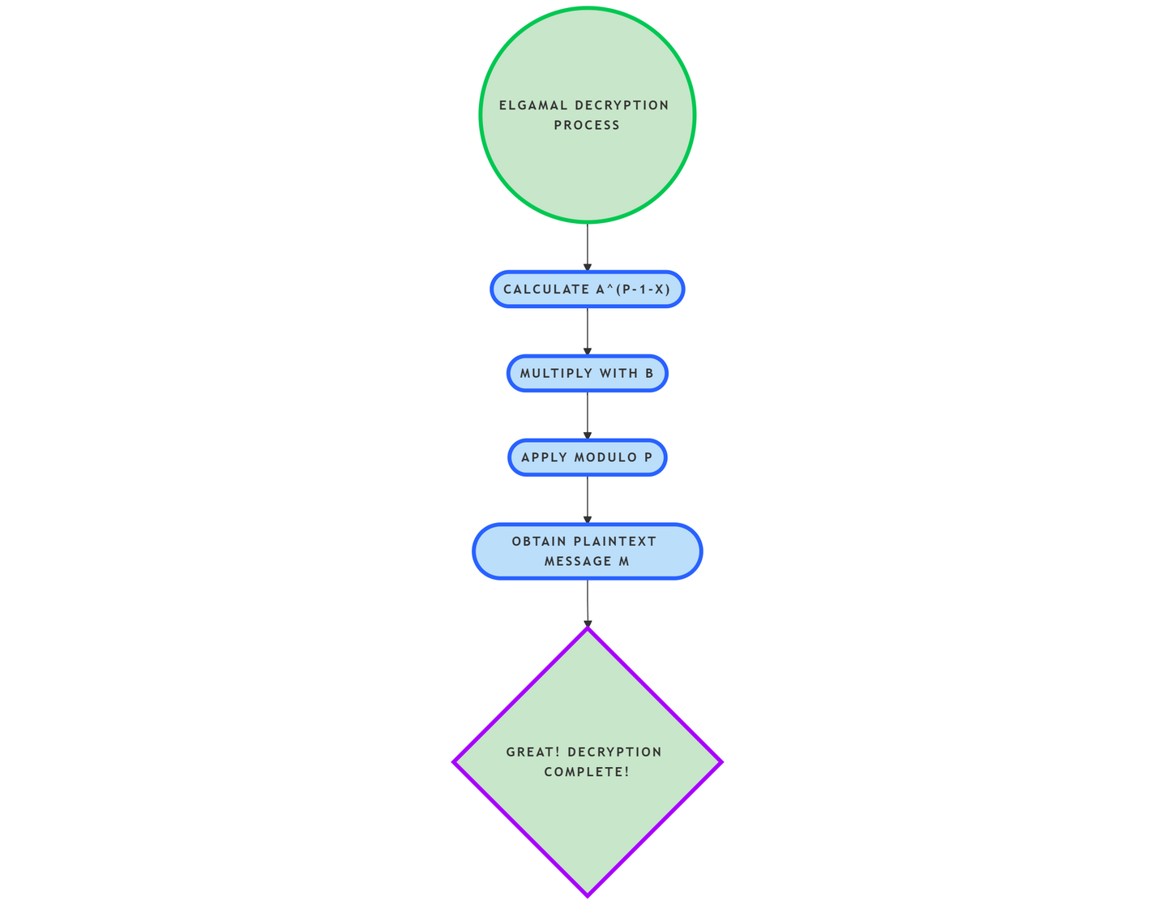
ELGAMAL CRYPTOSYSTEM:
DECRYPTION
ElGamal decryption recovers the original plaintext 'm' from the ciphertext (a, b) using the private key 'x' and the properties of modular arithmetic by doing the following:
Calculate a^(p-1-x): This step involves computing 'a' raised to the power of (p-1-x).
Multiply with 'b': Multiply the result from the previous step with 'b' (the second part of the ciphertext).
Apply Modulo p: Take the result from step 2 modulo 'p' to obtain the plaintext message 'm'.
Mathematically: m = (b * a^(p-1-x)) mod p

Slide 8
ELGAMAL CRYPTOSYSTEM:EXAMPLE
Key Generation:
Assume p = 11, g = 2, and private key x = 3.
Public key y = g^x mod p = 2^3 mod 11 = 8.
Encryption:
To encrypt message m = 7, choose k = 5.
a = g^k mod p = 2^5 mod 11 = 10.
b=m * y^k mod p = 7 * 8^5 mod 11 = 7 * 32768 mod 11 = 229376 mod 9 = 4.
Ciphertext is (10, 4).
Decryption
To decrypt: m = (b * a^(p-1-x)) mod p.
m = (4 * 10^(11-1-3)) mod 11 = (4 * 10^7) mod 11 = 40000000 mod 7
m = 7
This demonstrates the encryption and decryption process.

Slide 9
ELGAMAL CRYPTOSYSTEM:
APPLICATIONS
Digital Signatures: ElGamal variants are used in digital signature schemes like the DSA, ensuring message authenticity and integrity.
Cryptocurrencies: Some cryptocurrencies, such as ElGamal encryption-based blockchain implementations, leverage ElGamal for secure transaction processing.
Secure Email: ElGamal is employed in secure email protocols like Pretty Good Privacy (PGP) to protect the confidentiality.
GNU Privacy Guard (GPG): Core component of the GNU Privacy Guard software, widely used for file and email encryption.
Digital Voting: Present in some digital voting systems, such as Helios, to help ensure the secrecy and integrity of votes.

Slide 10

ELGAMAL CRYPTOSYSTEM:
ADVANTAGES
Strong Security: Its foundation in the discrete logarithm problem provides robust security against attacks.
Secure Key Exchange: Enables secure key exchange without requiring pre-shared secrets.
Versatility: Finds applications in various cryptographic schemes, including digital signatures and key agreement protocols.
Relative Simplicity: Comparatively easier to implement than some other public-key cryptosystems.
Semantic Security: Each encryption of the same message produces a different ciphertext, enhancing security.

Slide 11
ELGAMAL CRYPTOSYSTEM:
DISADVANTAGES
Ciphertext Expansion: The ciphertext is twice the size of the plaintext, impacting storage and bandwidth.
Computational Overhead: Encryption and decryption involve computationally expensive operations.
Malleability: Requires careful implementation to mitigate malleability concerns.
Parameter Selection: Security relies on choosing large prime numbers and strong generators, which can be complex.
Performance: Generally slower than symmetric key encryption for the same level of security.

Slide 12
ELGAMAL CRYPTOSYSTEM:
IMPLEMENTATION
ElGamal Class: Handles all the encryption and decryption using the ElGamal cryptosystem.
Serious Key Generation:We use a massive prime number, 115792089237316195423570985008687907853269984665640564039457584007908834671663, in our generateKeyPair() function. This provides a high level of security. We've set the generator to 2, a common choice for ElGamal.
Encryption with encrypt(): This function uses the recipient's public key to turn your message into a secret code using the ElGamal algorithm.
Decryption with decrypt(): Incoming messages are automatically decoded with your private key using this function.

Slide 13
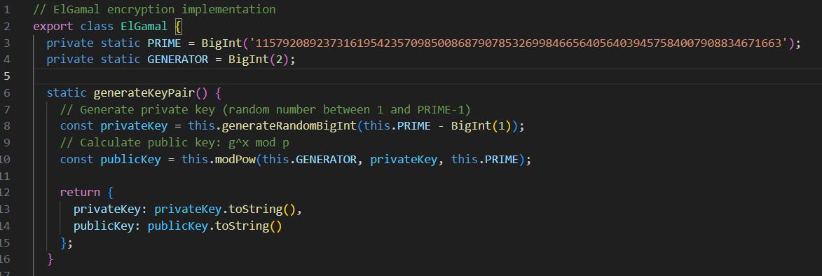
ELGAMAL CRYPTOSYSTEM:
IMPLEMENTATION

Slide 14
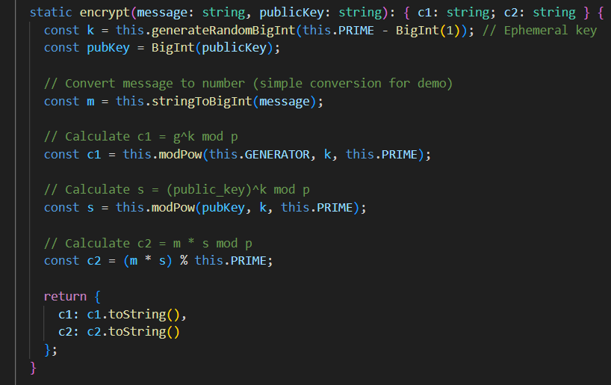
ELGAMAL CRYPTOSYSTEM:
IMPLEMENTATION

Slide 15
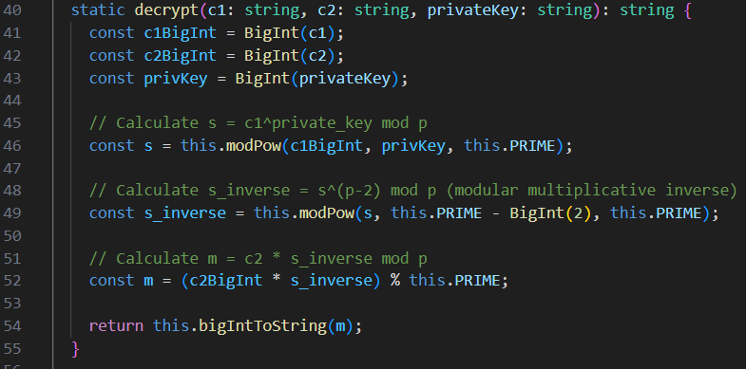
ELGAMAL CRYPTOSYSTEM:
IMPLEMENTATION

Slide 16
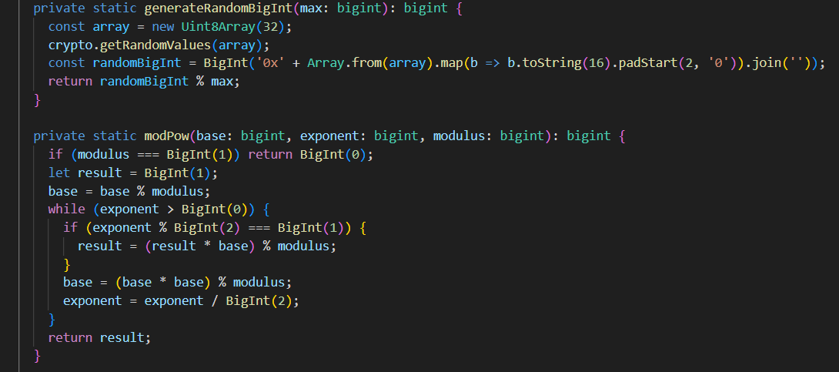
ELGAMAL CRYPTOSYSTEM:
IMPLEMENTATION

Slide 17
Thank you
Done By-CSE-B
Jagadheep UK CH.EN.U4CSE22120
JayanthRagavan M CH.EN.U4CSE22121
KavinKumar VS CH.EN.U4CSE22125
Mani Shankar SG CH.EN.U4CSE22130

